Slide 1

Covid 19 Analysis
2022MCS120009 (Santhosh Kumar N)
2019 to 2022

Slide 2
MINI PROJECT REPORT

Slide 3
Objective
To learn the steps, needed to be taken to prepare the data for an analysis
To learn how to look at the data to find a good measures to establish the analysis based upon
To learn to visualize the results of the analysis

Slide 4
Tools and Technology used
Programming Language : R Programing
Library : Dplyr, tidyr, leaflet
Plotting and Visualization : ggplot2

Slide 5
Programming Objective
Splitting of data into subsets
Imputation and Interpolation of missing value
Sorting by columns and ranges
Selecting and slicing data
Joining, concatenating and Joins
Grouping, calculation of aggregate and binning

Slide 6
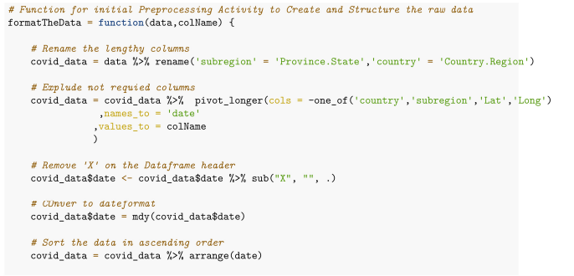
Function for initial Preprocessing
Rename the Column header
Exclude not required columns
Remove ‘X’ from the header when read data as csv file
Convert to Date Time format
Sort the data on required order
Round off the values for specific columns

Slide 7
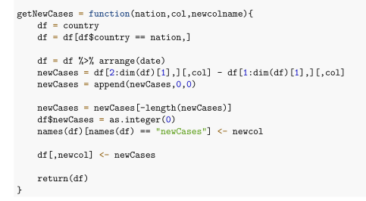
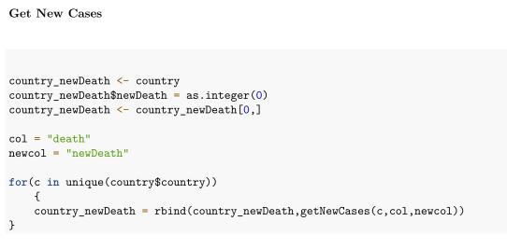
Get ‘Confirmed’ ‘Death’ and ‘Recovered’ Cases
Analyzing and segregation data based on the Cases reported
Cases reported based on Death , confirmed and Recovered
Compute new variables ‘ActiveCases’ and ‘newCases’ ‘newDeath’ ‘newRecovered’

Slide 8
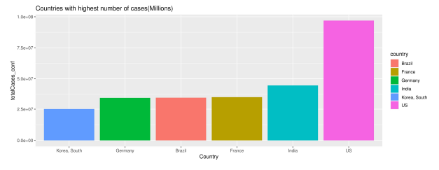
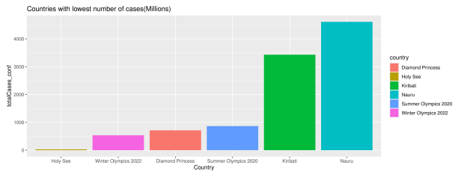
Countries with highest and lowest number of cases
‘United states’ has highest covid cases reported so far with number of 100,456,053
‘India’ is in second place where total reported cases are 44,672,304
Looking at the lowest or least cases reported are ‘Holy See’

Slide 9
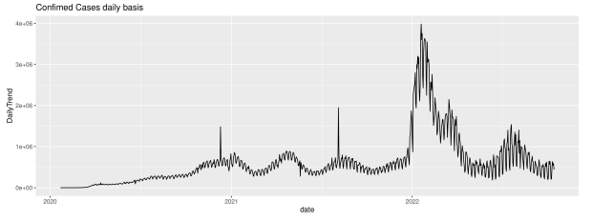
Trend Analysis for Confirmed Cases
Cases reported rise from 2020 are not exponential growth or decline
Looking at the trend where highest number cases reported daily wise where beginning of 2022 March it has reported peak.
Also observed that number are started declining from June 2022

Slide 10
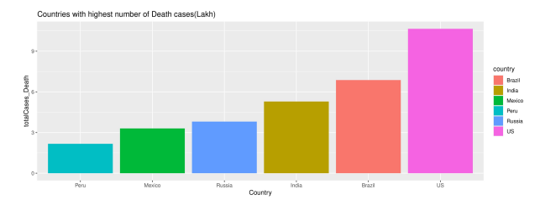
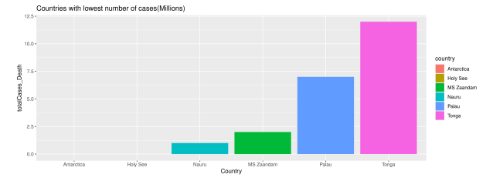
Countries with highest and lowest number of Death cases
‘United states’ has highest death cases so far with number of 1,104,743
‘India’ is in second place where total death cases are 530,604
Looking at the lowest or least death cases are ‘Holy See’

Slide 11
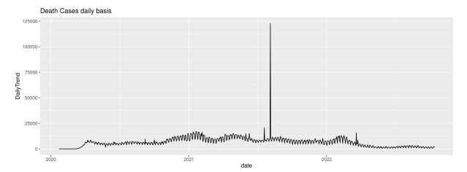
Trend Analysis for Death Cases
Death cases observed are not exponential growth
After 2022 Death Cases started declining

Slide 12
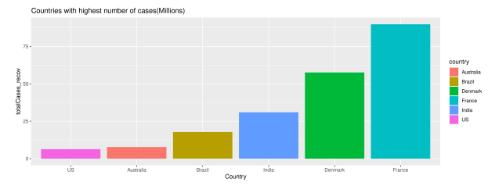
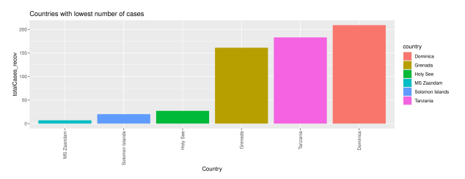
Countries with highest and lowest number of recovered cases
‘Australia’ has highest recovered cases so far with number of 7,50,456
‘Denmark’ is in second place where total death cases are 530,604
Looking at the lowest or least recovered cases are ‘US’

Slide 13
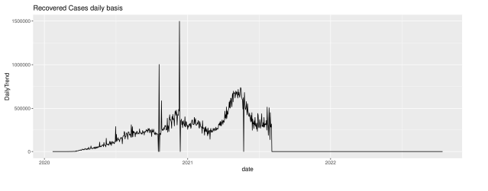
Trend Analysis for Recovered Cases
Recovered cases observed are in positive trend after mid of 2020

Slide 14
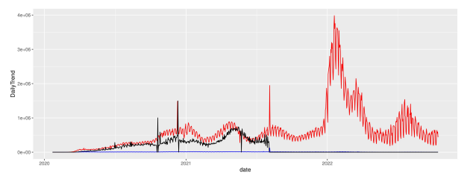
Pair plot Trend Analysis for all kind of cases
Here we have observed that how the trends are correlated

Slide 15
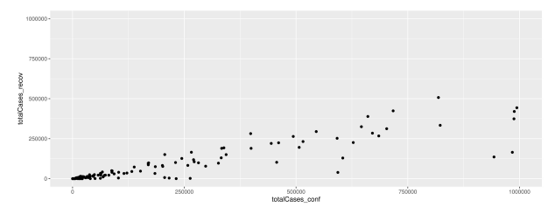
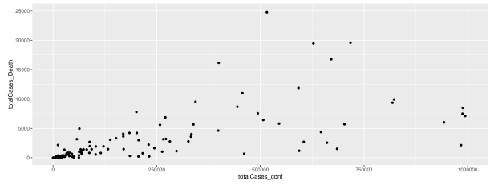
Correlation plot for cases reported versus recovered and death
Correlation tell us a mutual relationship or connection between two variable.
There is positive correlation observed where Total cases confirmed recovered and Death cases

Slide 16
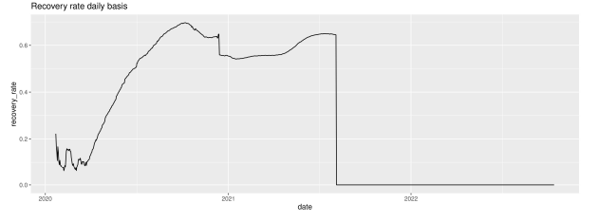
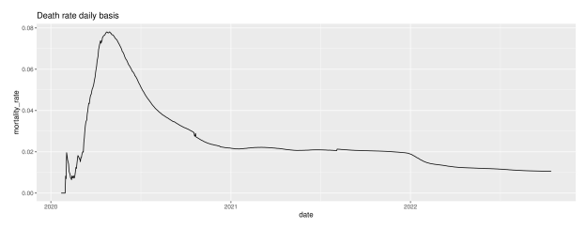
Recovery rate analysis
The diagonal lines on the chart below correspond to different case fatality ratios
Countries falling on the uppermost lines have the highest observed case fatality ratios.

Slide 17
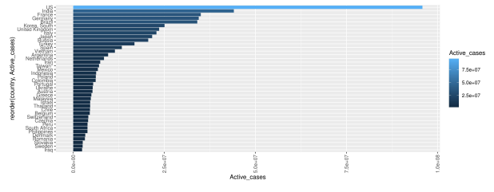
Active cases Country wise
Active cases Country wise , Here US is in first place where more number of active cases reported

Slide 18
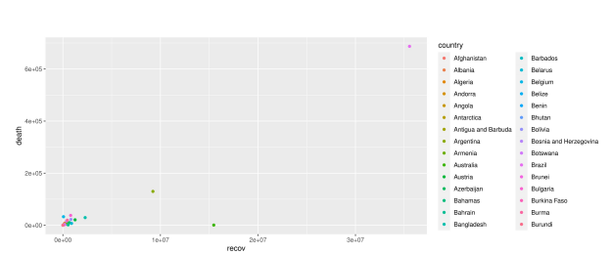
Recovered vs Death correlation county wise
Correlation relationship between recovered and death cases country wise

Slide 19
Thank you

